Slide 1
C The Programing Language

Slide 2

Introduction to C Language
C is a programming language.
It was developed at AT & T’s Bell Laboratories of USA in 1972.
It was designed and written by a man named Dennis Ritchie.
Reliable, Simple and easy to use.
Dennis Ritchie

Slide 3
Where C stands:
All programming languages can be divided into two categories:
Problem oriented languages or High level languages e.g. FORTRAN, BASIC, PASCAL.
Machine oriented or Low level Languages e.g. Assembly language, Machine Language.
C stands in between these two categories. Also called Middle Level Language.

Slide 4
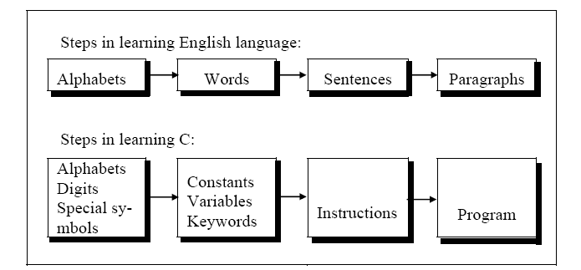
Getting started with C.

Slide 5
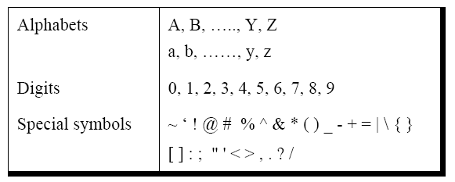
The C character Set:
A character denotes any alphabet, digit or special symbol used to represent information.

Slide 6
Constants, Variables and Keywords:
The alphabets, numbers and special symbols when properly combined form constants, variables and keywords.
A constant is an entity that doesn’t change whereas a variable is an entity that may change

Slide 7
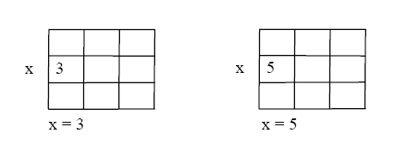
Here 3 is stored in a memory location and a name x is given to it. Then we are assigning a new value 5 to the same memory location x. This would overwrite the earlier value 3, since a memory location can hold only one value at a time.

Slide 8
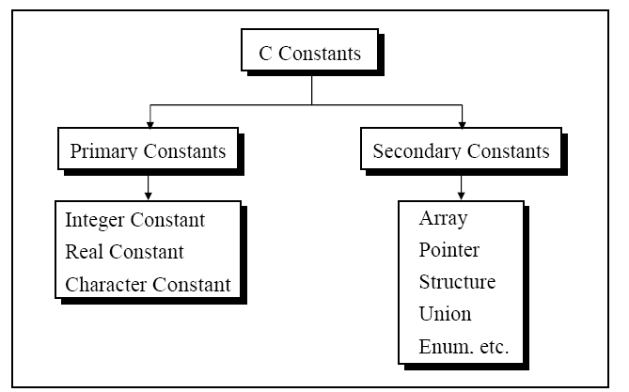
Types of C constant:
C constants can be divided into two major categories:
Primary Constants
Secondary Constants

Slide 9
Rules for Constructing Integer Constants:
An integer constant must have at least one digit.
It must not have a decimal point.
It can be either positive or negative.
If no sign precedes an integer constant it is assumed to be positive.
No commas or blanks are allowed within an integer constant.
The allowable range for integer constants is -32768 to 32767.
Ex.: 426
+782
-8000
-7605

Slide 10
Rules for Constructing Real Constants
A real constant must have at least one digit.
It must have a decimal point.
It could be either positive or negative.
Default sign is positive.
No commas or blanks are allowed within a real constant.
Ex.: +325.34
426.0
-32.76
-48.5792

Slide 11
Rules for Constructing Character Constants:
A character constant is a single alphabet, a single digit or a single special symbol enclosed within single inverted commas. Both the inverted commas should point to the left. For example, ’A’ is a valid character constant whereas ‘A’ is not.
The maximum length of a character constant can be 1 character. Ex.: 'A'
'I'
'5'
'='

Slide 12
Types of C Variables
A variable name is any combination of 1 to 31 alphabets, digits or underscores. Some compilers allow variable names whose length could be up to 247 characters. Still, it would be safer to stick to the rule of 31 characters. Do not create unnecessarily long variable names as it adds to your typing effort.
The first character in the variable name must be an alphabet or underscore.
No commas or blanks are allowed within a variable name.
No special symbol other than an underscore (as in gross_sal) can be used in a variable name.
Ex.: si_int
m_hra
pop_e_89

Slide 13
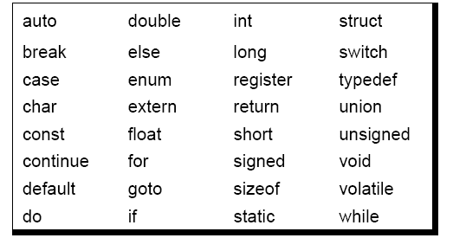
C keywords:

Slide 14
Writing C program:

Slide 15
Some Definitions
Syntax(form):-The syntax of a language describes the possible combinations of symbols that form a correct program.
IDE:- It is a screen display with pull down menus. We use menu selections to invoke all the operations necessary to develop our program.

Slide 16
Compiler:- It is the part of IDE, that translates our source file into machine language.
Keyword:- Keywords are the words whose meaning has already been explained to the C compiler

Slide 17
My first Program
#include<stdio.h>
void main(void)
{
printf(“How are you!”);
}

Slide 18
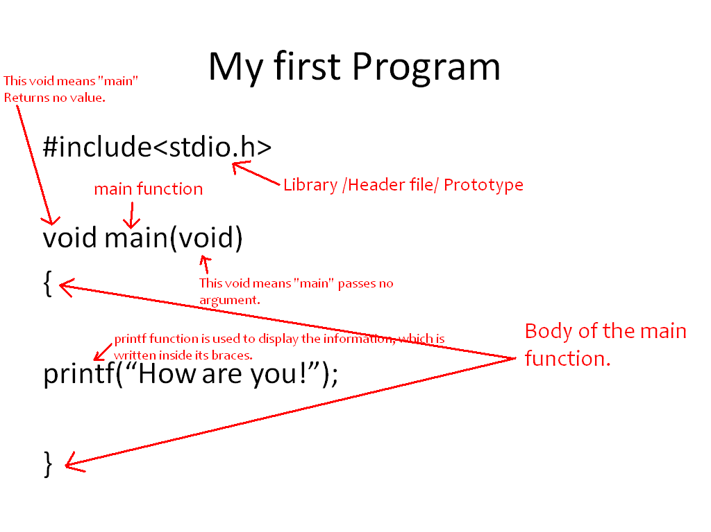

Slide 19
Output
How are you!

Slide 20
The general form of printf( ) function is,
printf ( "<format string>", <list of variables> ) ;
<format string> can contain,
%f for printing real values
%d for printing integer values
%c for printing character values
In addition to format specifiers like %f, %d and %c the format string may also contain any other characters. These characters are printed as they are when the printf( ) is executed.
Following are some examples of usage of printf( ) function:
printf ( "%f", si ) ;
printf ( "%d %d %f %f", p, n, r, si ) ;
printf ( "Simple interest = Rs. %f", si ) ;
printf ( "Price = %d \nRate = %f", p, r ) ;

Slide 21
Example:
/* Calculation of simple interest */
/* Author gekay Date: 25/05/2004 */
void main( )
{
int p, n ;
float r, si ;
p = 1000 ;
n = 3 ;
r = 8.5 ;
/* formula for simple interest */
si = p * n * r / 100 ;
printf ( "%f" , si ) ;
}

Slide 22
Compilation and Execution
Once the program has been typed it needs to be converted to machine language (0s and 1s) before the machine can execute it. To carry out this conversion we need another program called Compiler.
Compiler vendors provide an Integrated Development Environment (IDE) which consists of an Editor as well as the Compiler.

